Slide 1

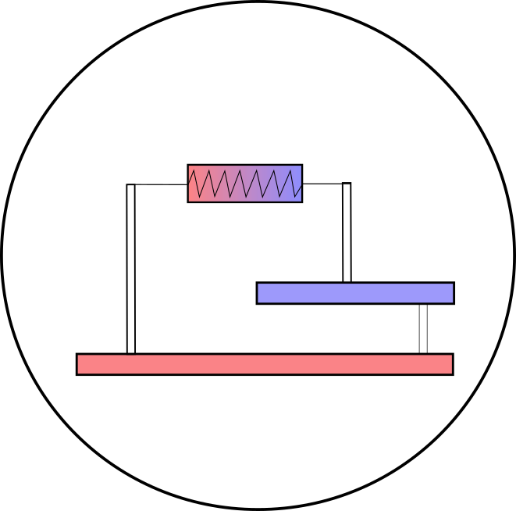


Investigating geothermal heat resources of legacy mine workings: Why are some mine waters hotter than others?
Mylene Receveur
Christopher McDermott, Stuart Gilfillan, Andrew Fraser-Harris, Ian Watson
Notes:
I am going to talk about geothermal energy, and more specifically about the low temperature resources that we can find in abandoned flooded mines. Geothermal is not only steaming ground, but it can be found everywhere, even in mines, But mines are more complex than conventional sedimentary geothermal reservoirs, My researches focus in understanding the temperature distribution in coal mines in the UK, the sources of heat and recharge mechanisms to evaluate their geothermal potential.

Slide 2
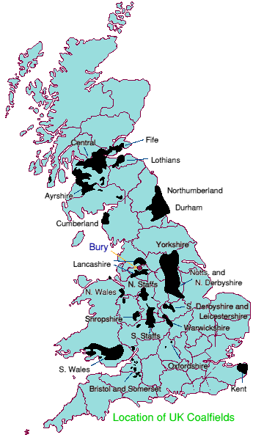
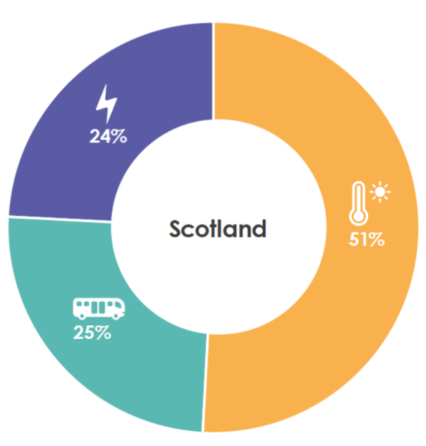
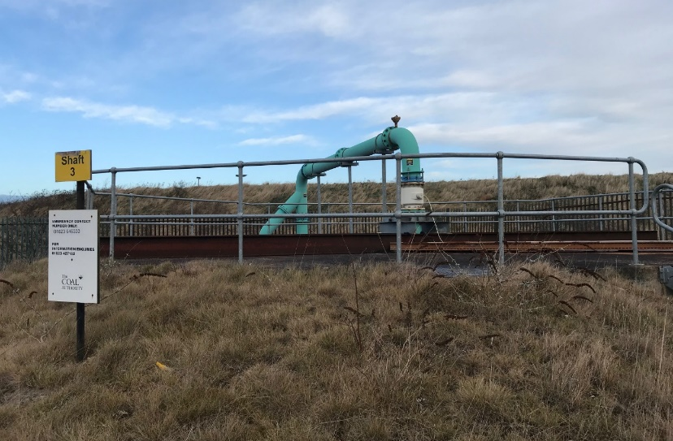
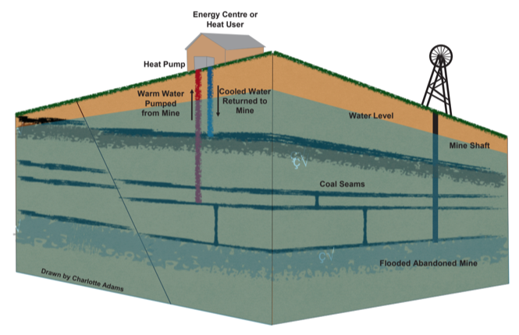
Introduction
Chapter 2
Chapter 3
Chapter 1
Methods
Conclusion
BACKGROUND
Minewater heat: a new local energy source to reach decarbonization targets
Mine-water heat: 7% of Scotland’s heat demand (Todd et al., 2019)
Schematic diagram of a mine water heat pump system (Adams et al. 2019)
Notes:
Why is it important? Minewater geothermal has massive potential:
Co-location with population density : Most of the UK and Scotland have underground coal workings (9% of UK population located above abandonned coal mines)
Potential for regeneration of mining communities
Now all abandoned and flooded as pumping ceased → Existing 12-20 °C resource at 200-800m depth
Making use of existing mine legacy (and potential liability for the CA) = Mine closed but could still be mined for heat, as flooded, and pumping already implemented (Coal Authority)
Coal authority interest – finance pumping fees they are responsible for (avoid mine-water surface contamination)
How much primary energy usage goes to heating in the UK = 50 %
Fiona estimated that this warm water could provide 7% of UK requirement of heat → could participate to the UK target to decarbonizing heat and meet the 2024 requirement
A few case studies of GSHP on coal mines already exist worldwide, including 2 implemented systems in the UK and Scotland.
- At Heerlen, abandoned mines are used to deliver space heating and cooling to around 200,000 m2 of mixed use new and retrofit buildings via a 7-km-long heat network
- In Shettleston, where at least 6 seams have been mined, the water is heated to 55°C through a heat exchanger, to provide heat to 16 dwellings.
- In Lumphinnans, at least 11 seams belonging to the Lower Carboniferous Limestone Coal Group have been mined (including the uppermost Lochgelly Black Band Ironstone, the Seven Foot Seam, the Kelty Main, the Jersey or Diamond Seam and the Swallowdrum (Burke 1999)).
How does this work? Open-loop GSHP systems - Can be used for space / hot water heating
Warm water can be extracted at high rates from enhanced-permeability reservoirs because large voids.
In the UK, those voids (mine shafts, tunnels, workings) are in the coal measures (shallow early mining) and down to 800 m depth (LCR, deep mining)
GSHP used to extract heat from the ground or from the water using open-loop systems.
Injection/production of cold/hot water can be reversed seasonally. Proven to increase the system lifetime.
Extracting water can induce inflow of recharge water (from infiltration, lateral aquifers), or re-injection can be performed. → Need to know how fast heat is recharged

Slide 3
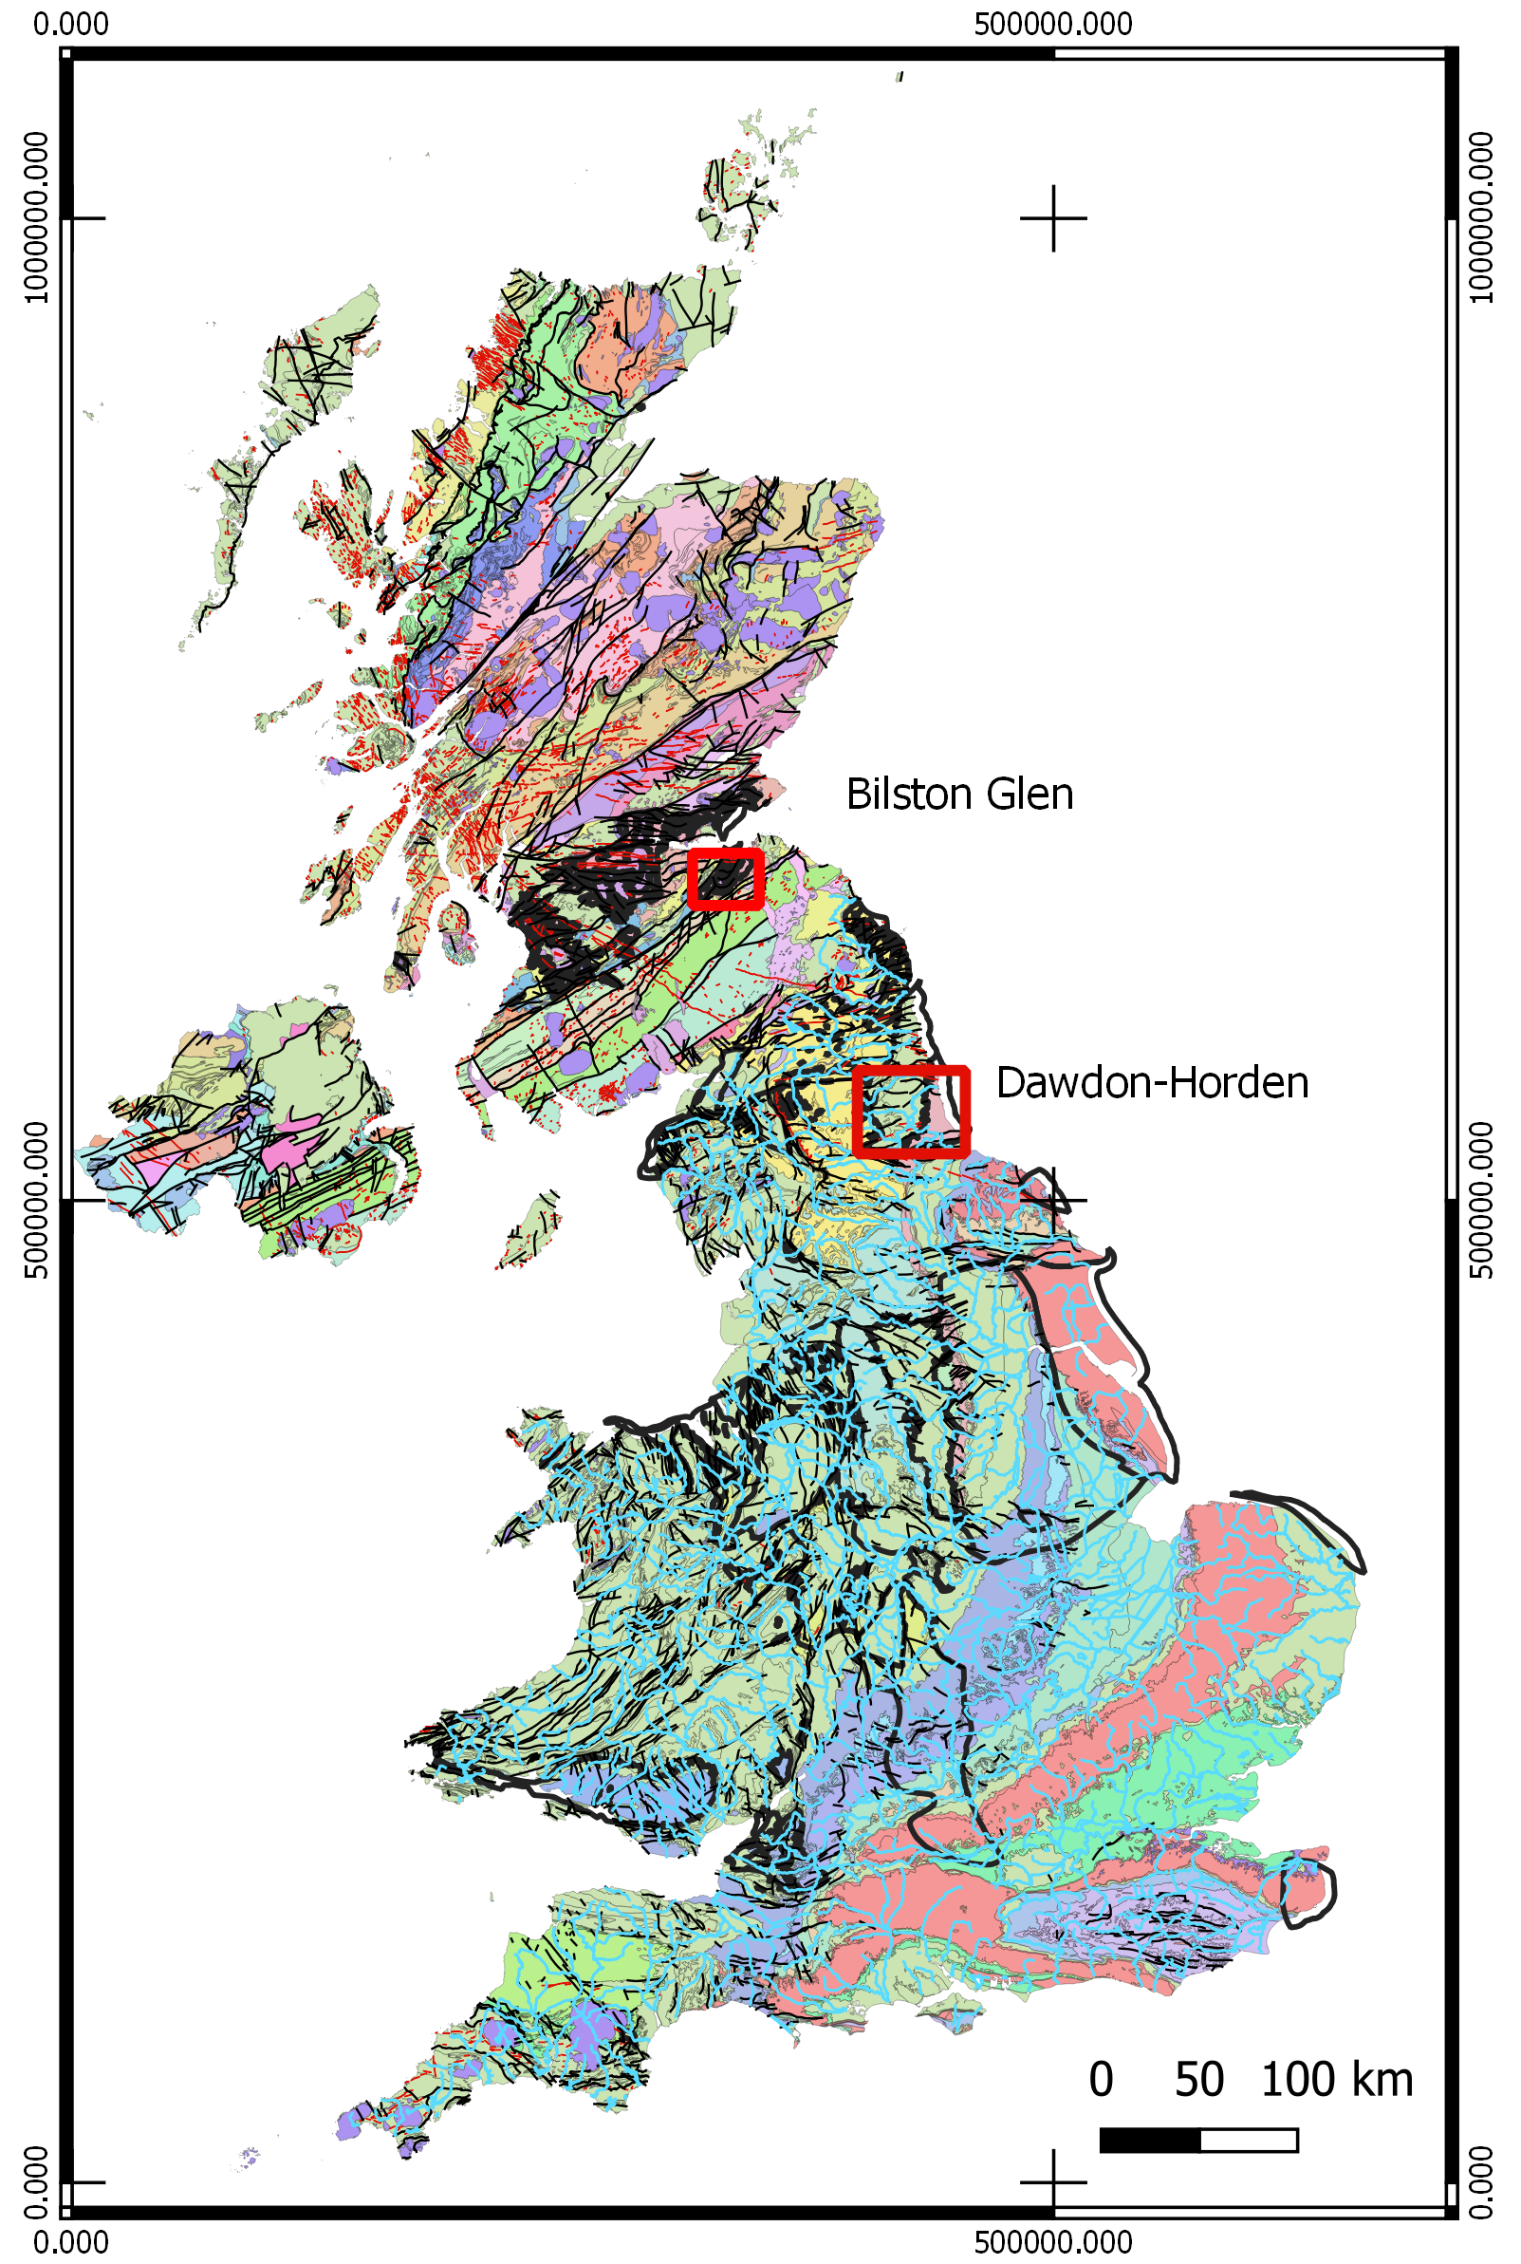
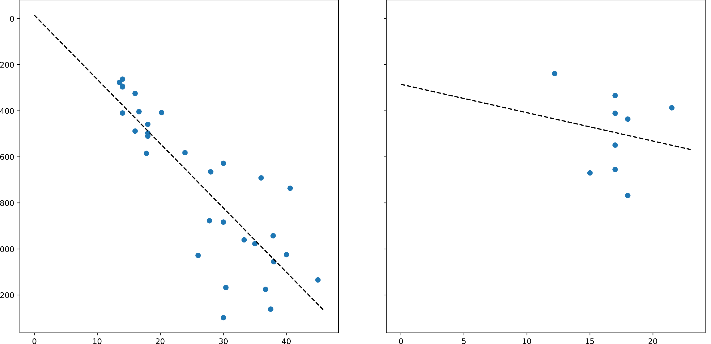
Introduction
Chapter 2
Chapter 3
Chapter 1
Methods
Conclusion
Research questions
Bottom Hole temperature Mine-water temperature
T= 8 + 0.03 z
Depth
Temperature Temperature
Why do different mines have different temperatures?
What are the key heat recharge mechanisms and heat sources controlling the water temperature in flooded coal mines
What is the impact of past mining activities on the thermal state and temperature distribution in mines?
What are the key mine features allowing to assess the sustainable heat potential of coal mines at the scale of a mine?
Notes:
However, a recent study showed that there is no clear correlation between temperature and depth, in the measurements taken in shafts and boreholes of several mines.
So the temperature in mines does not only depends on the geothermal gradient,
However, it is essential to understand from where the heat comes from to estimate the long-term potential and suitability of heat production from coal mine = how fast will the heat be replenished = need to get a better understanding of the source of heat and recharge mechanisms,
The research will involve numerical modelling of mines, calibrated and validated using real data from 2 different areas:
- Bilston Glen in Scotland
- Dawdon in NE England
Objective 1:
create hydrological/thermal conceptual model(s) of flooded coal mines to identify the main controls on mines temperatures.
develop a numerical approaches able to discriminate between the contribution from different types of heat fluxes induced by heat extraction and heat/water recovery
Objective 2:
determine the thermal state of a mine after a period of mining and flooding.
assess the initial temperature distribution within a mine to evaluate its original heat potential
Objective 3:
assess the key features in mine plans having significant impact on the heat depletion and rate of energy recharge at the scale of a mine or network of interconnected mines
create representative but simplified model of mine workings will be developed in order to assess the potential of mines, in terms of energy storage/heat capacity.
define the extent of the area impacted by heat extraction around the production well, depending on the mine structure.

Slide 4
RQ1: What are the key heat recharge mechanisms and heat sources controlling the water temperature in flooded coal mines?
Introduction
Chapter 2
Chapter 3
Chapter 1
Methods
Conclusion
Questions:
What are the main heat sources in coal mines?
What are the main heat transfer processes?
What is the footprint area of heat extraction? Can thermal steady state be reached?
Hypothesis:
H0 – Heat advection in tunnels is dominant during production.
H2 – Vertical conductive recharge is dominant during recovery.
H3 – Solar heat recharge is negligible relative to the geothermal heat flux.
WHAT ?

Slide 5
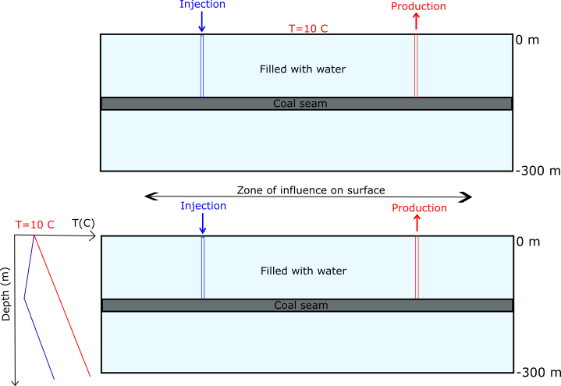
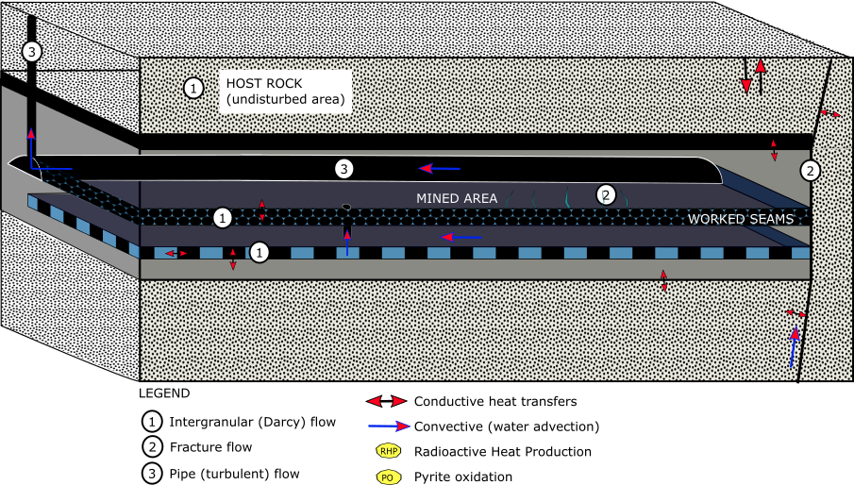
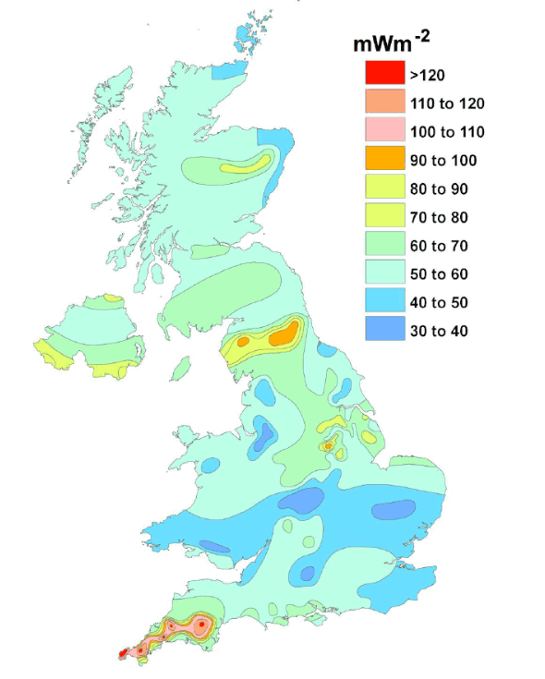
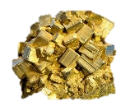
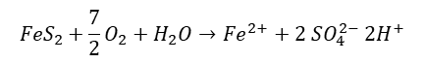
Conceptual models
Introduction
Chapter 2
Chapter 3
Chapter 1
Methods
Conclusion
Solar flux
Rainfall
$${FeS}_{2}+\frac{7}{2}O_{2}+H_{2}O→{Fe}^{2+}+2 {SO}_{4}^{2−} {2H}^{+}$$
Notes:
First step: create a conceptual model to identify the sources of heat and fluxes.
Complex geometry and mixed/interconnected processes → need to be isolated/simplify the problems before attempting to solve them numerically and get an overall understanding on the processes,
This will allow to assess the contribution from different elements on the heat generation and renewal in mines, both through mathematical, analytical and numerical models::
This includes:
natural heat flow / geothermal gradient
Local heat generation : radiactive decay, pyrite oxidation
solar influx
Groundwater flow = convective flux
Geological structure: geological formation with specific material, thermal and hydraulic properties; geological disturbances (i.e. faults)
Still uncertainties about the origin of recharge water (heat source or sink?): assess the heat exchange rate with surrounding rocks

Slide 6
What are the key heat recharge mechanisms and heat sources controlling the water temperature in flooded coal mines?
Introduction
Chapter 2
Chapter 3
Chapter 1
Methods
Conclusion
Questions:
What are the main heat sources in coal mines?
What are the main heat transfer processes?
What is the footprint area of heat extraction? Can thermal steady state be reached?
Hypothesis:
H0 – Solar heat recharge is negligible relative to the geothermal heat flux.
H1 – Vertical conductive recharge is dominant during recovery.
H2 – Heat advection is dominant during production.
Notes:
How does those heat sources contribute to the recharge implies understanding the heat fuxes, hence the second question,

Slide 7
What are the key heat recharge mechanisms and heat sources controlling the water temperature in flooded coal mines?
Introduction
Chapter 2
Chapter 3
Chapter 1
Methods
Conclusion
Questions:
What are the main heat sources in coal mines?
What are the main heat transfer processes?
What is the footprint area of heat extraction? Can thermal steady state be reached?
Hypothesis:
H0 – Solar heat recharge is negligible relative to the geothermal heat flux.
H1 – Vertical conductive recharge is dominant during recovery.
H2 – Heat advection is dominant in tunnels during production VS heat conduction in mine workings.
HOW ?
WHERE ?
WHEN ?
Methods:
Numerical modelling: OpenGeosys
Sensitivity analysis
Notes:
What is the water-rock heat exchange rate in mined areas (i.e. goaf) and tunnels, depending on:
The water source / temperature
The flow rate
The rock properties (i.e. permeability, thermal conductivity)
The flow path length

Slide 8
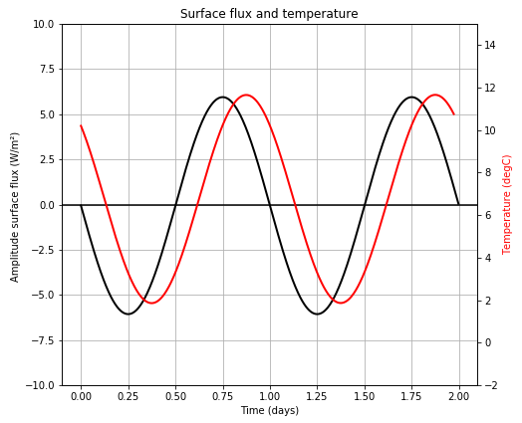
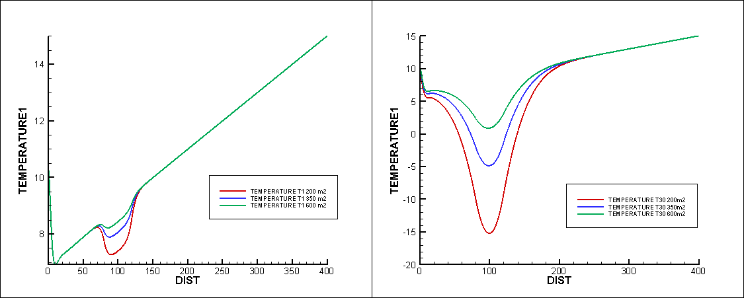
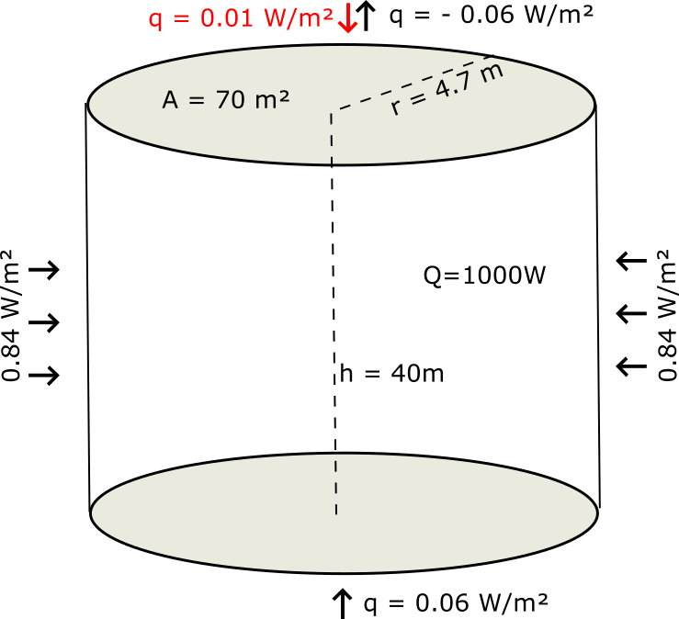
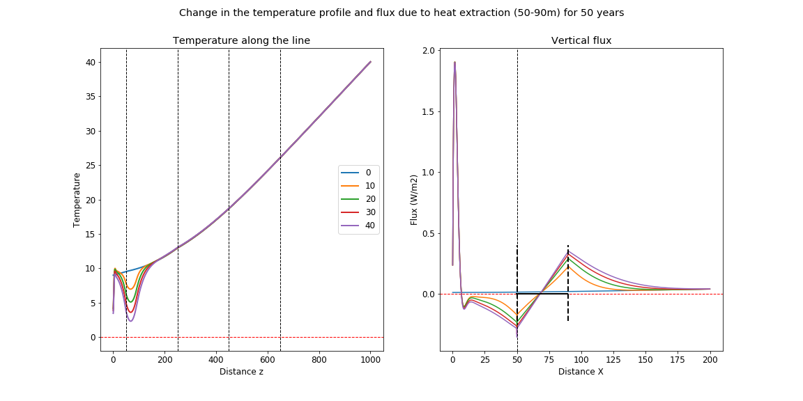
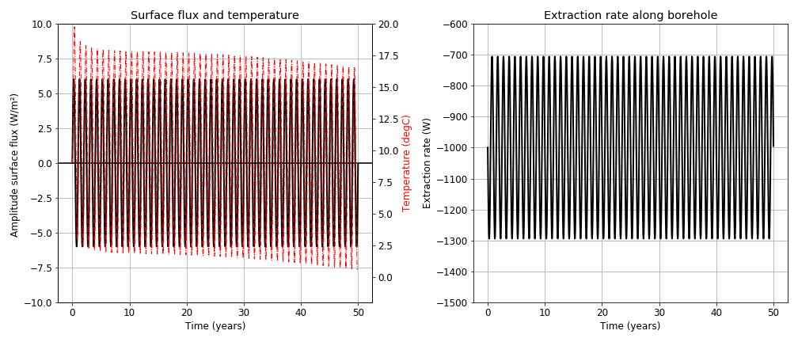
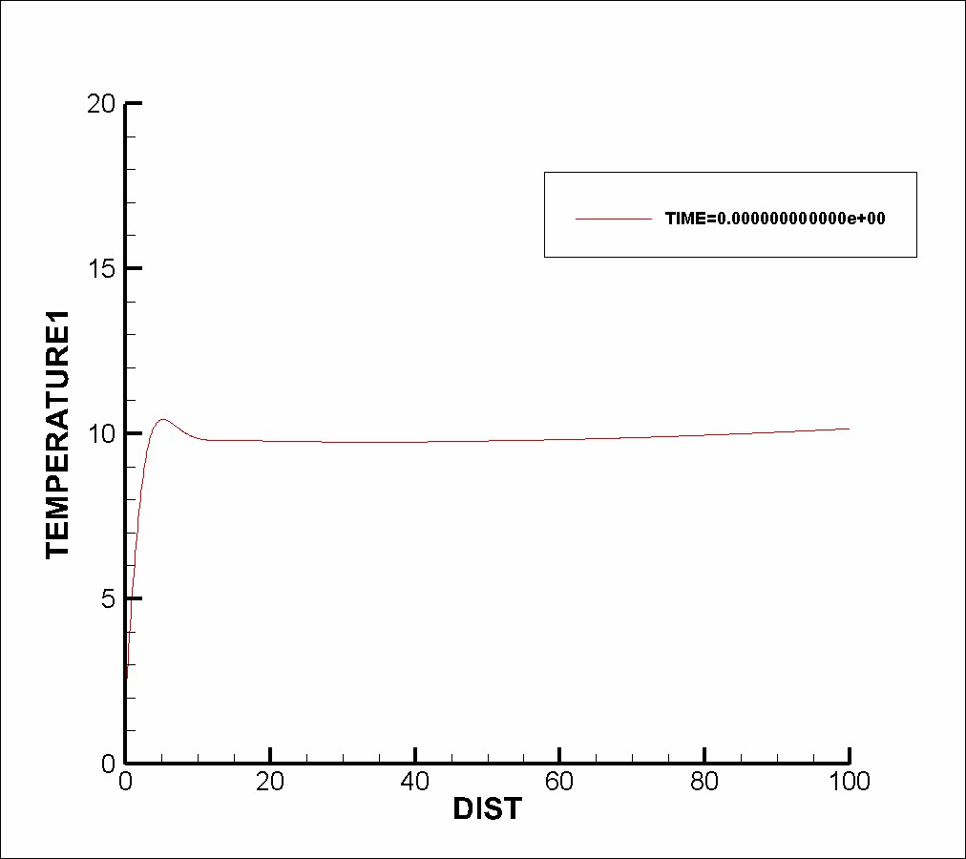
Initial Results
Introduction
Chapter 2
Chapter 3
Chapter 1
Methods
Conclusion
H0 – Vertical recharge - Solar VS geothermal
1) What is ∆q ?
2) What area ?
-1000 W/yr
Notes:
Need to speak in terms of flux
Most of previous studies considered fixed temperature at top BC but not correct for shallow systems
Sensitivity analysis on geometrical, technical or numerical parameters

Slide 9
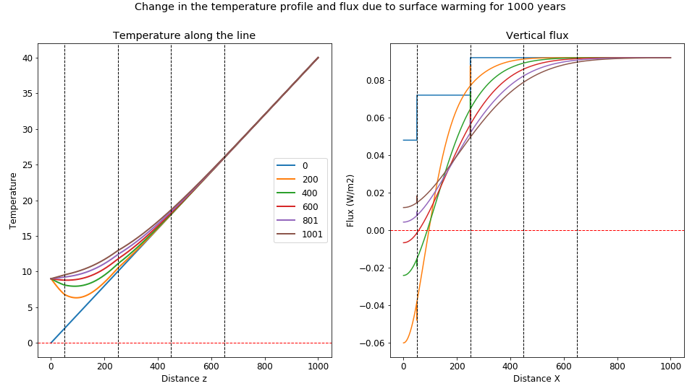
Initial Results
Introduction
Chapter 2
Chapter 3
Chapter 1
Methods
Conclusion
H0 - Vertical recharge - Impact of initial temperature gradient on the vertical fluxes

Slide 10
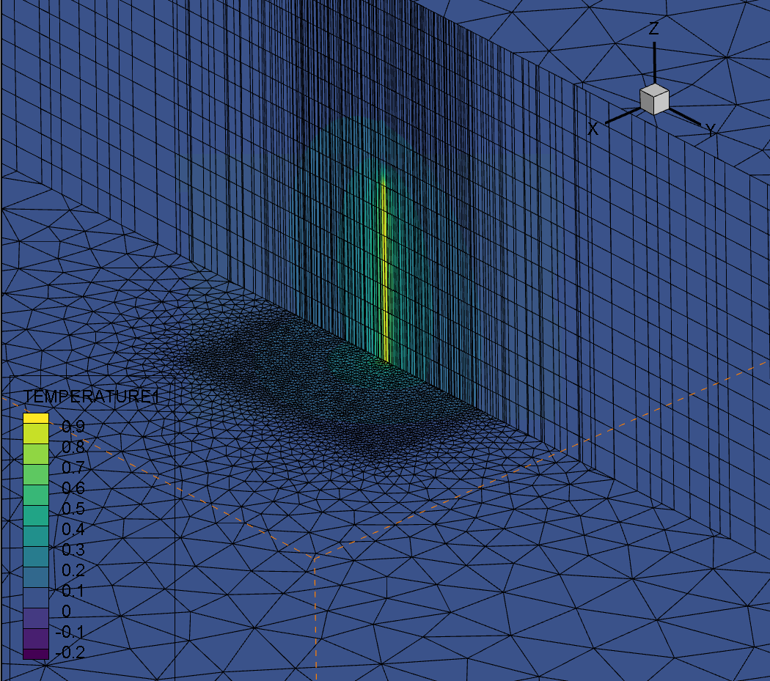
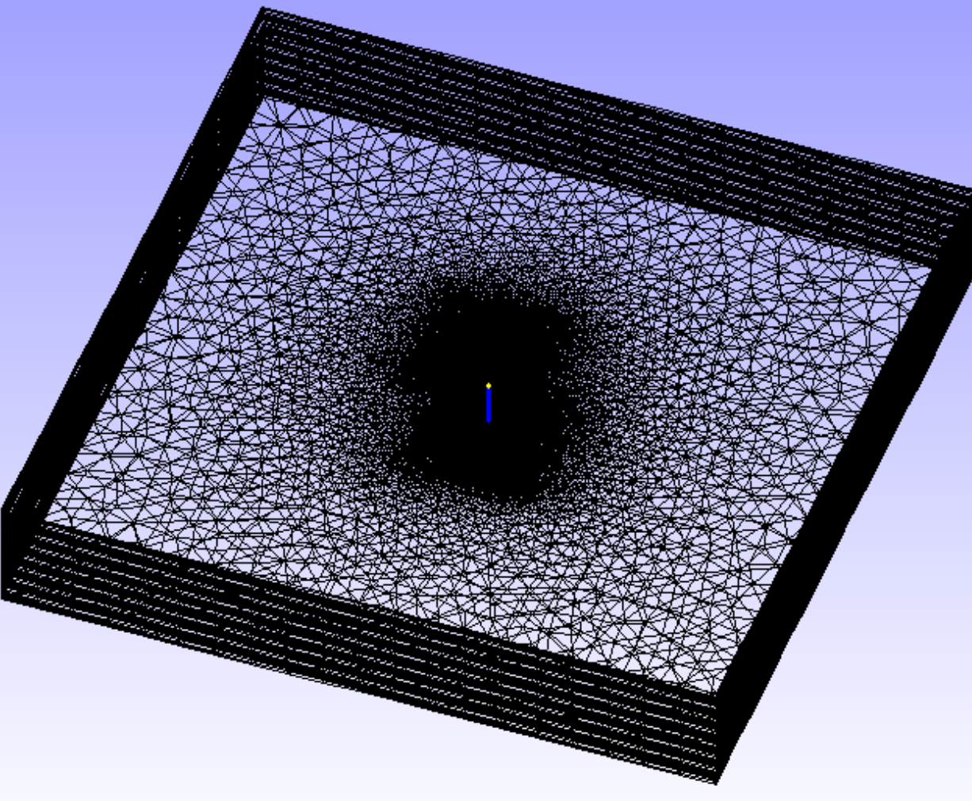
NEXT STEP
Introduction
Chapter 2
Chapter 3
Chapter 1
Methods
Conclusion
H0 - Vertical recharge VS horizontal conductive flux
Notes:
Need to speak in terms of flux
Most of previous studies considered fixed temperature at top BC but not correct for shallow systems
Sensitivity analysis on geometrical, technical or numerical parameters

Slide 11

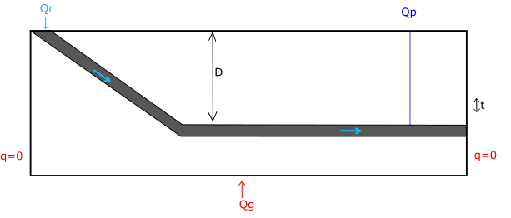

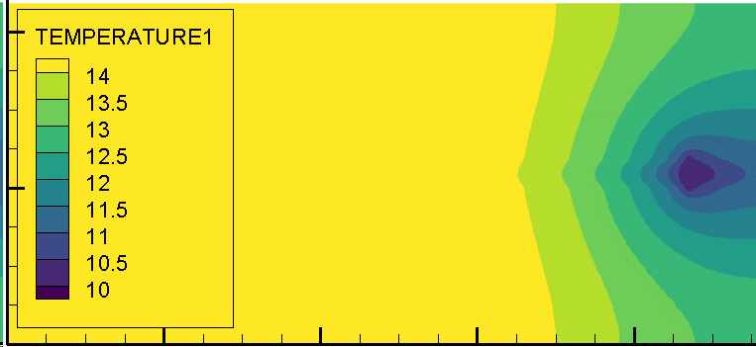
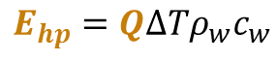
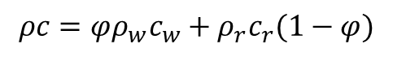
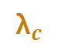


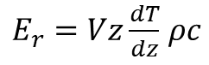
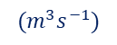

Next step
Introduction
Chapter 2
Chapter 3
Chapter 1
Methods
Conclusion
H1 – Vertical conductive recharge is dominant during recovery.
H2 – Heat advection is dominant in tunnels during production VS heat conduction in mine workings.
= Effect of natural vs forced water flow
T°C ?
$$E_{hp}=Q∆Tρ_{w}c_{w}$$
$$Q_{r}$$
$$(m^{3}s^{−1})$$
$${\text{λ}}_{c}$$
$${\text{λ}}_{r}$$
T°C ?
$$Q_{r}$$
L
h
$E_{r}=Vz\frac{dT}{dz}$ $ρc$
$$ρc=φρ_{w}c_{w}+ρ_{r}c_{r}(1−φ)$$
Notes:
What is the rock-water heat exchange rate in mined areas (i.e. goaf) and tunnels during production depending on:
The void type (geometry, volume of pores)
The rock properties (i.e. permeability, thermal conductivity)
The source/temperature of water
The path length
The flow rate (i.e. pumping and/or infiltration rate)
The volume of water extracted vs the energy extracted
Simulation of cold water injection/recharge will allow determining, through sensitivity analysis, the parameters the more likely to influence mine water temperature (relative contrinution of each).
= Need to understand groundwater processes and how they superimposed onto conductive/undisturbed geothermal gradient in highly conductive layers
= contrasts in rock properties differes from conventional aquifer, where i.e. sanstone (porous/permeable) generally have higher conductivity and surrounding low-k low-K layer allow a slow recharge of the system
How does it affect the footprint area ?
How does it contribute to energy recharge relative to purely conductive situations ?
This leads to chapter 2 – as mines might not be at equilibrium / due to the past activities within the mine

Slide 12
Introduction
Chapter 2
Chapter 3
Chapter 1
Methods
Conclusion
Next step
Questions:
What are the main heat sources in coal mines?
What are the main heat transfer processes?
What is the footprint area of heat extraction? Can thermal steady state be reached?
Hypothesis:
H0 – Solar heat recharge is negligible relative to the geothermal heat flux.
H1 – Vertical conductive recharge is dominant during recovery.
H2 – Heat advection is dominant in tunnels during production VS heat conduction in mine workings.
H3 – Thermal balance can be reached for low extraction rate
Notes:
What is the water-rock heat exchange rate in mined areas (i.e. goaf) and tunnels, depending on:
The water source / temperature
The flow rate
The rock properties (i.e. permeability, thermal conductivity)
The flow path length

Slide 13
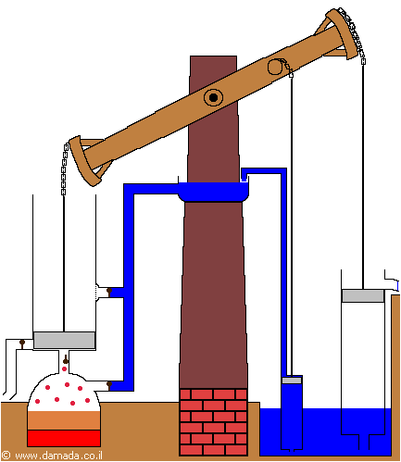
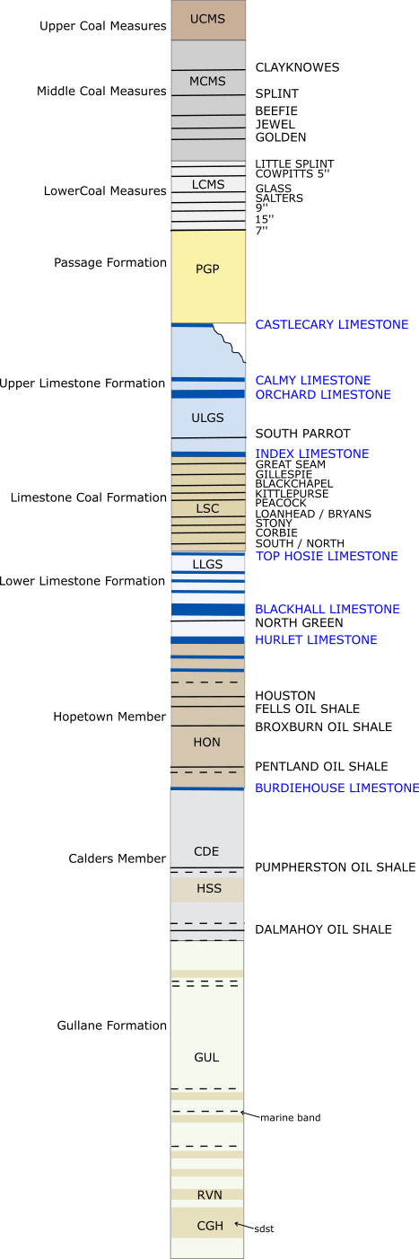
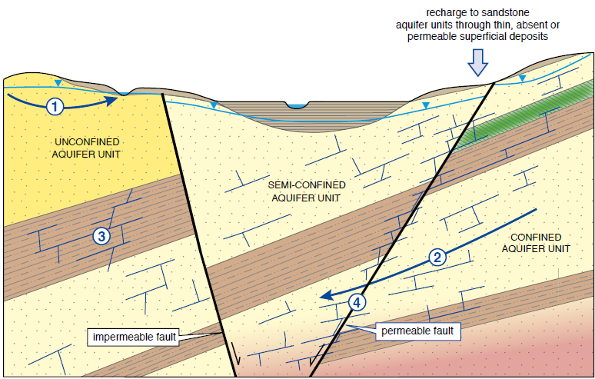
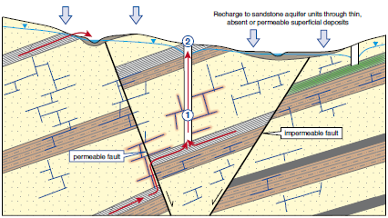
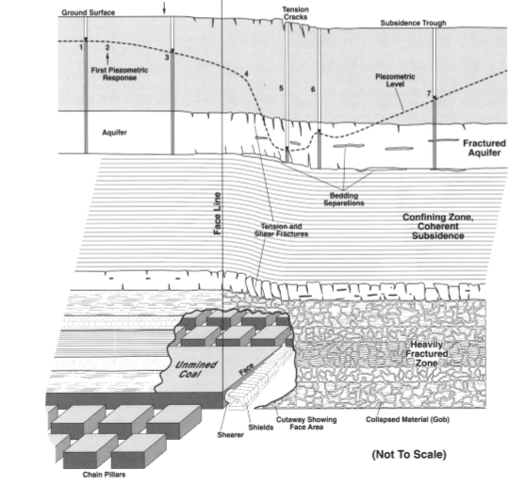
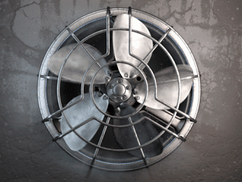
what is the footprint of past mining activities on the thermal state and temperature distribution in mines?
Introduction
Chapter 2
Chapter 3
Chapter 1
Methods
Conclusion
1) Before mining
1) During mining
1) After mining
Booth et al. (2000)
O Dochartaigh (2015)
Hypothesis:
H0 - "partial equilibrium" is reached in flooded mine after 20 years
H1 – Water advection during flooding maintains anomalous temperature (isothermal conditons)
H2 – Temperature in shafts VS rock temperature gives clues for source of recharge water (BC)
↗K, ↗Ф
Notes:
Questions:
Does the temperature gradient in mines re-equilibrate with the undisturbed regional gradient?
What is the extent of the perturbations caused by water advection in large mining voids on heat distribution in mines?
Is the temperature profile in shafts representative (during flooding/pumping)?
Chapter 2 will therefore aim at understanding:
What is the initial temperature distribution within the mines ?
We expect that the initial temperature in mines depends on « leaks between tunnels and regional hydrology »
A challenge is to define the right boundary conditions, hence H2
Through H1: mine workings could be modelled as sink/source of heat, depending on the source of water and natural head gradien

Slide 14
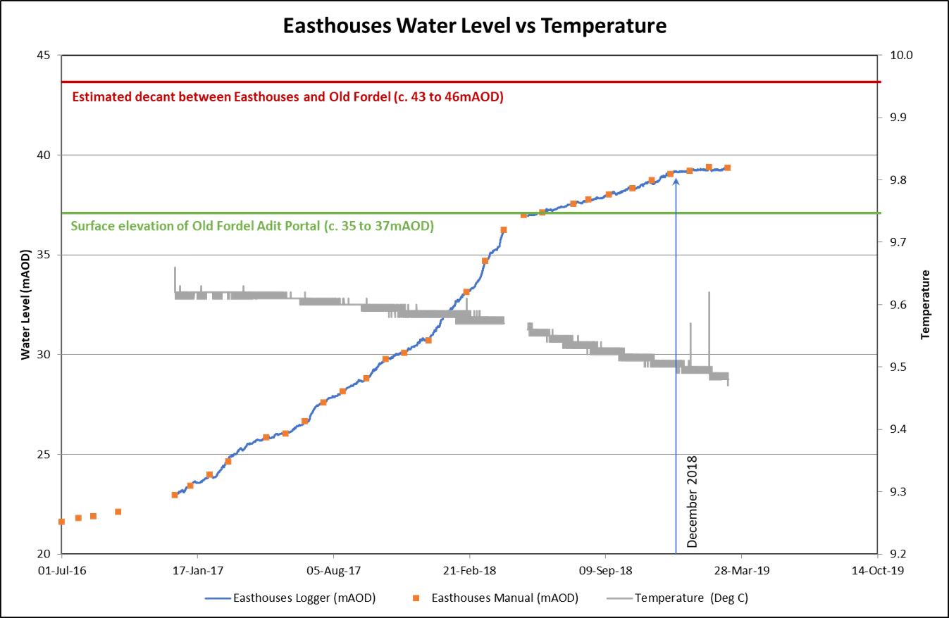
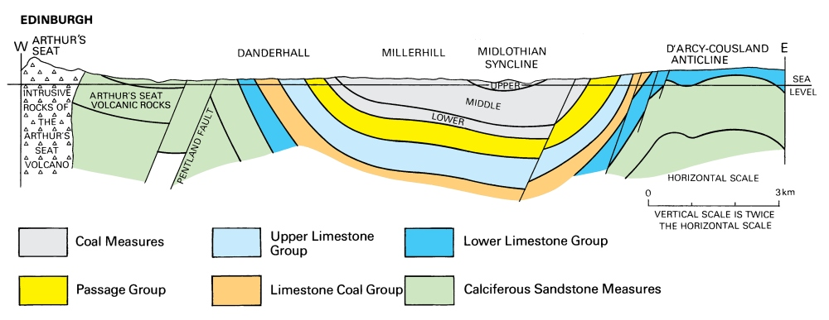
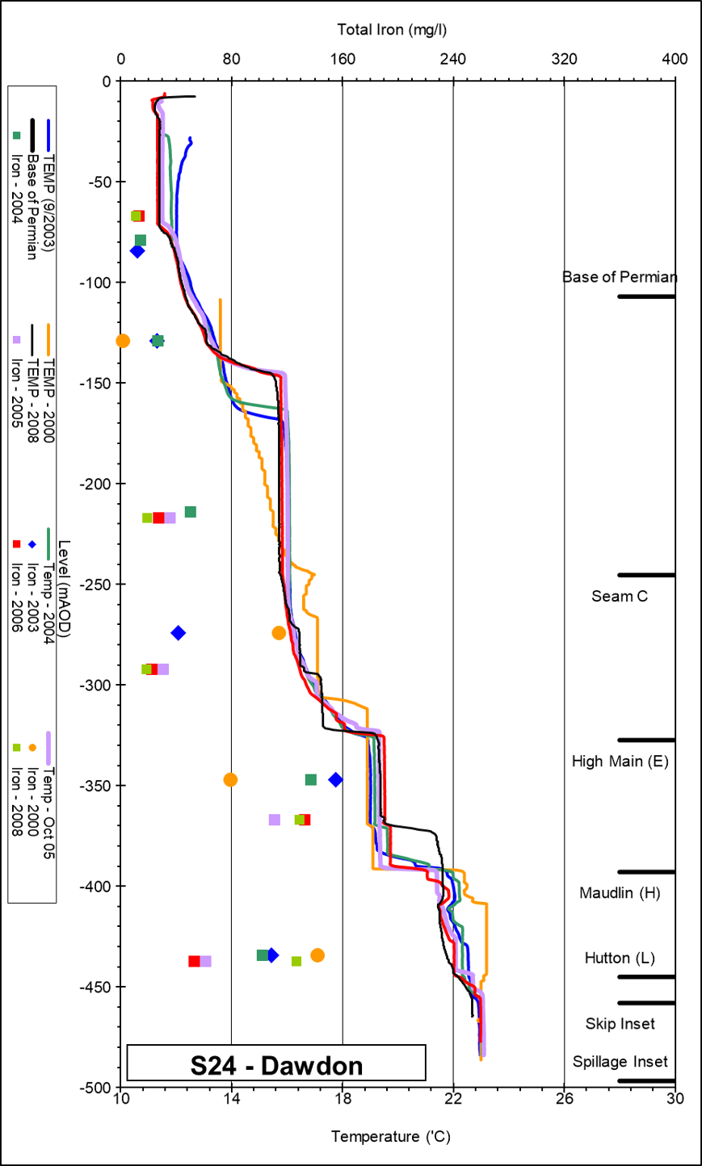
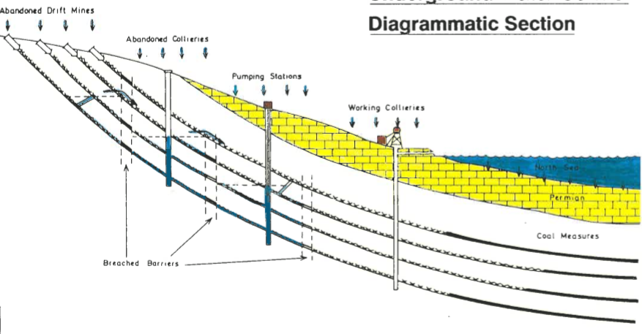
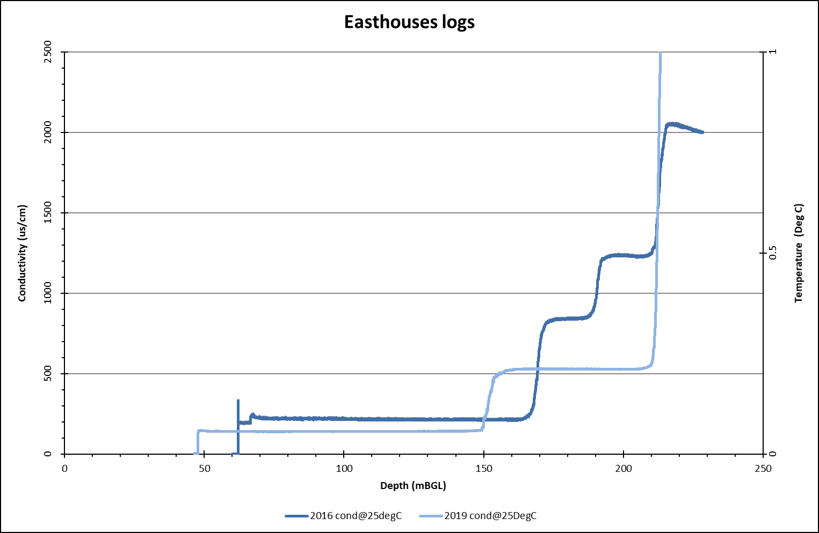
Model Calibration & verification
Introduction
Chapter 2
Chapter 3
Chapter 1
Methods
Conclusion
Based on existing data:
Bilston Glen (Scotland)
Dawdon (NE-England)
Notes:
Calibration and validation of model using existing data from Bilston Glen in Scotland - Dawdon in NE England by simulation of flooding / temperature recovery
→ Enough data and two different geometries (dipping layer / syncline)
Data types to fit: T-EC profiles and time series (water level, temperature), geochemistry (deep water in Dawdon = Chloride anion dominant = long residence time / Shallow water in Bilston Glen (Bicarbonate dominant) according to Chebotarev chart
Based on calibrated model, evaluation of the recharge rate / heat recovery rate of mine water.
→ How long can it be sustained? what is the footprint area for providing heat for domestic heating?

Slide 15
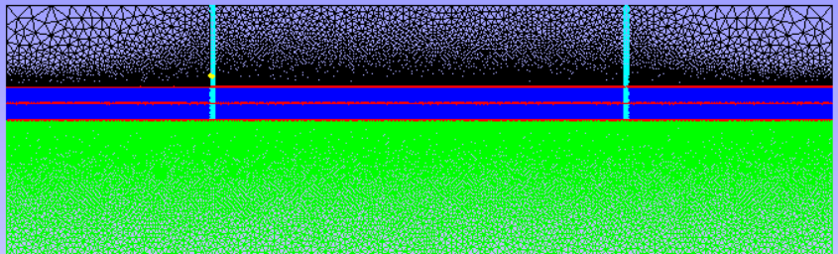
Numerical approach
Introduction
Chapter 2
Chapter 3
Chapter 1
Methods
Conclusion
Methods:
2D models Diffusion-Advection
Pumping / Recovery
Effect of boundary conditions

Slide 16
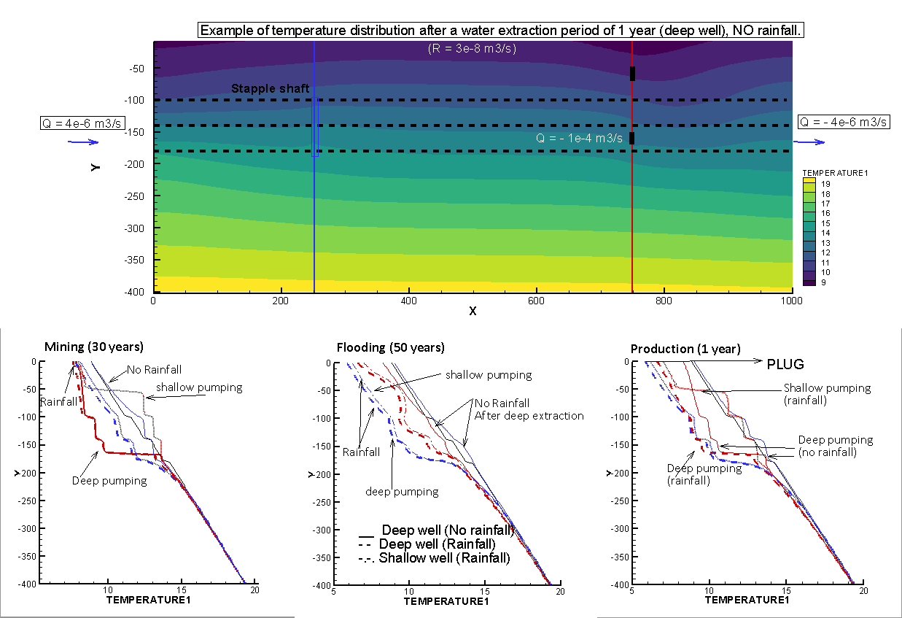
Initial results
Introduction
Chapter 2
Chapter 3
Chapter 1
Methods
Conclusion

Slide 17
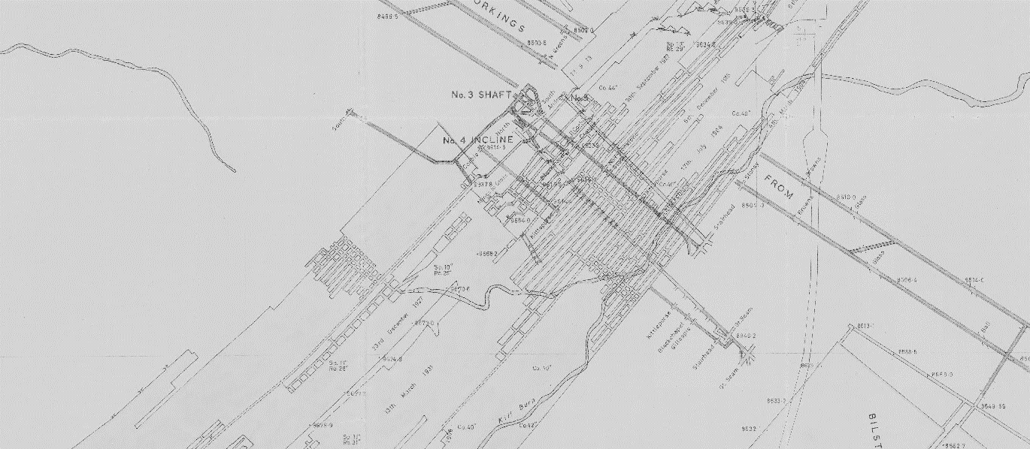
What are the key mine features allowing to assess the sustainable heat potential of coal mines at the scale of a mine?
Introduction
Chapter 2
Chapter 3
Chapter 1
Methods
Conclusion
Questions:
How can we simplify mine plans to build representative models ?
2D / 3D ?
Level of details ?
Notes:
Mine plans are complex. A certain level of simplification is necessary. To what extent can we simplify it and what features are really important?

Slide 18
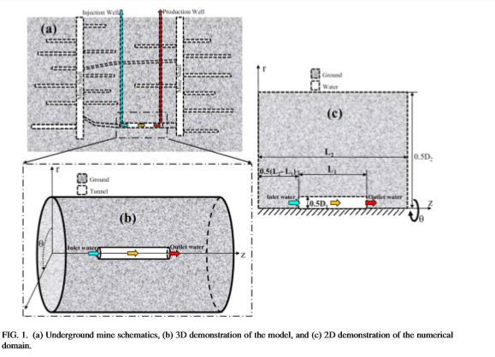
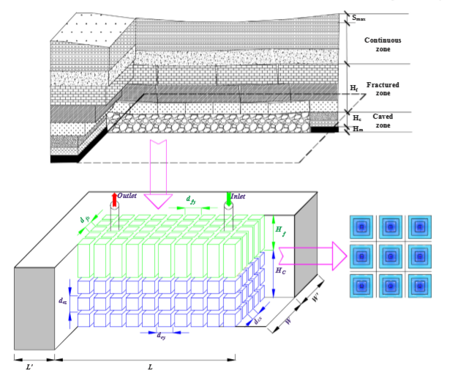
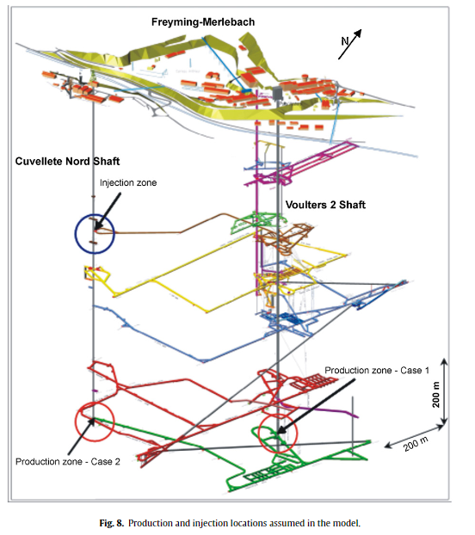
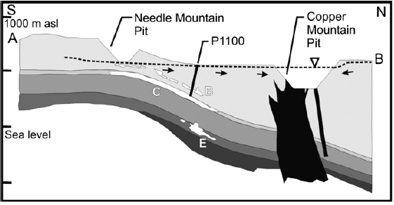
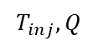
Past Modelling approaches
Introduction
Chapter 2
Chapter 3
Chapter 1
Methods
Conclusion
Mine geometry
Roof k
$$T_{inj}, Q$$
Equivalent porous media for mine workings
Density effects
λ, k, V
Mine tunnels
(Ghoreishi Madeish et al., 2012)
Dual porosity medium
(Guo et al., 2018)
3D model of shaft/roadway connections
(Hamm et al., 2010)
Combined 3D porous medium and 1D pipe flow
(Raymond and Therrien, 2008)
Notes:
Modeling of mines done before
Both generic cases and specific case study
Both for tunnels / workings systems
Raymond and Therrien: quite complex and global modelling approach
Difficulty in mine systems (which differs from usual aquifers) is the necessity to solve for water, heat and mass transport in a system composed of a porous media (Darcy flow) and open void (pipe flow) that can lead to numerical instability. Has been overcome by combining 1D, 2D and 3D elements
But don’t evaluate the contribution of each parameter (assume all heat comes from heat flux)

Slide 19
What are the key mine features allowing to assess the sustainable heat potential of coal mines at the scale of a mine?
Introduction
Chapter 2
Chapter 3
Chapter 1
Methods
Conclusion
Hypothesis
H2 - The lateral extent, volume and interconnectivity of the roadway network is a key control on the overall heat capacity of the mine (i.e. heat depletion rate).
H3 – λ, T and ∆k tunnels, mined area and unaffected host rock is a key feature to assess the overall ∆heat in the system and the rate of energy transfer.
H0 - The voids geometry does not impact the heat exchange rate
H1 – An "equivalent porosity" and "equivalent heat capacity" parameter can be defined to scale up 3D properties / processes in vertical 2D models.
Notes:
Hypothesis: The interconnectivity of the roadway network affect the total accessible volume of rock and then the amplitude/direction of fluxes induced during production, hence the overall heat exchange rate and heat depletion rate.
Evaluate the footprint area of heat extraction
What is the geothermal potential of mines?
Can a sustainable heat extraction rate be maintained?
¹ direction/amplitude of induced fluxes during production/recovery

Slide 20
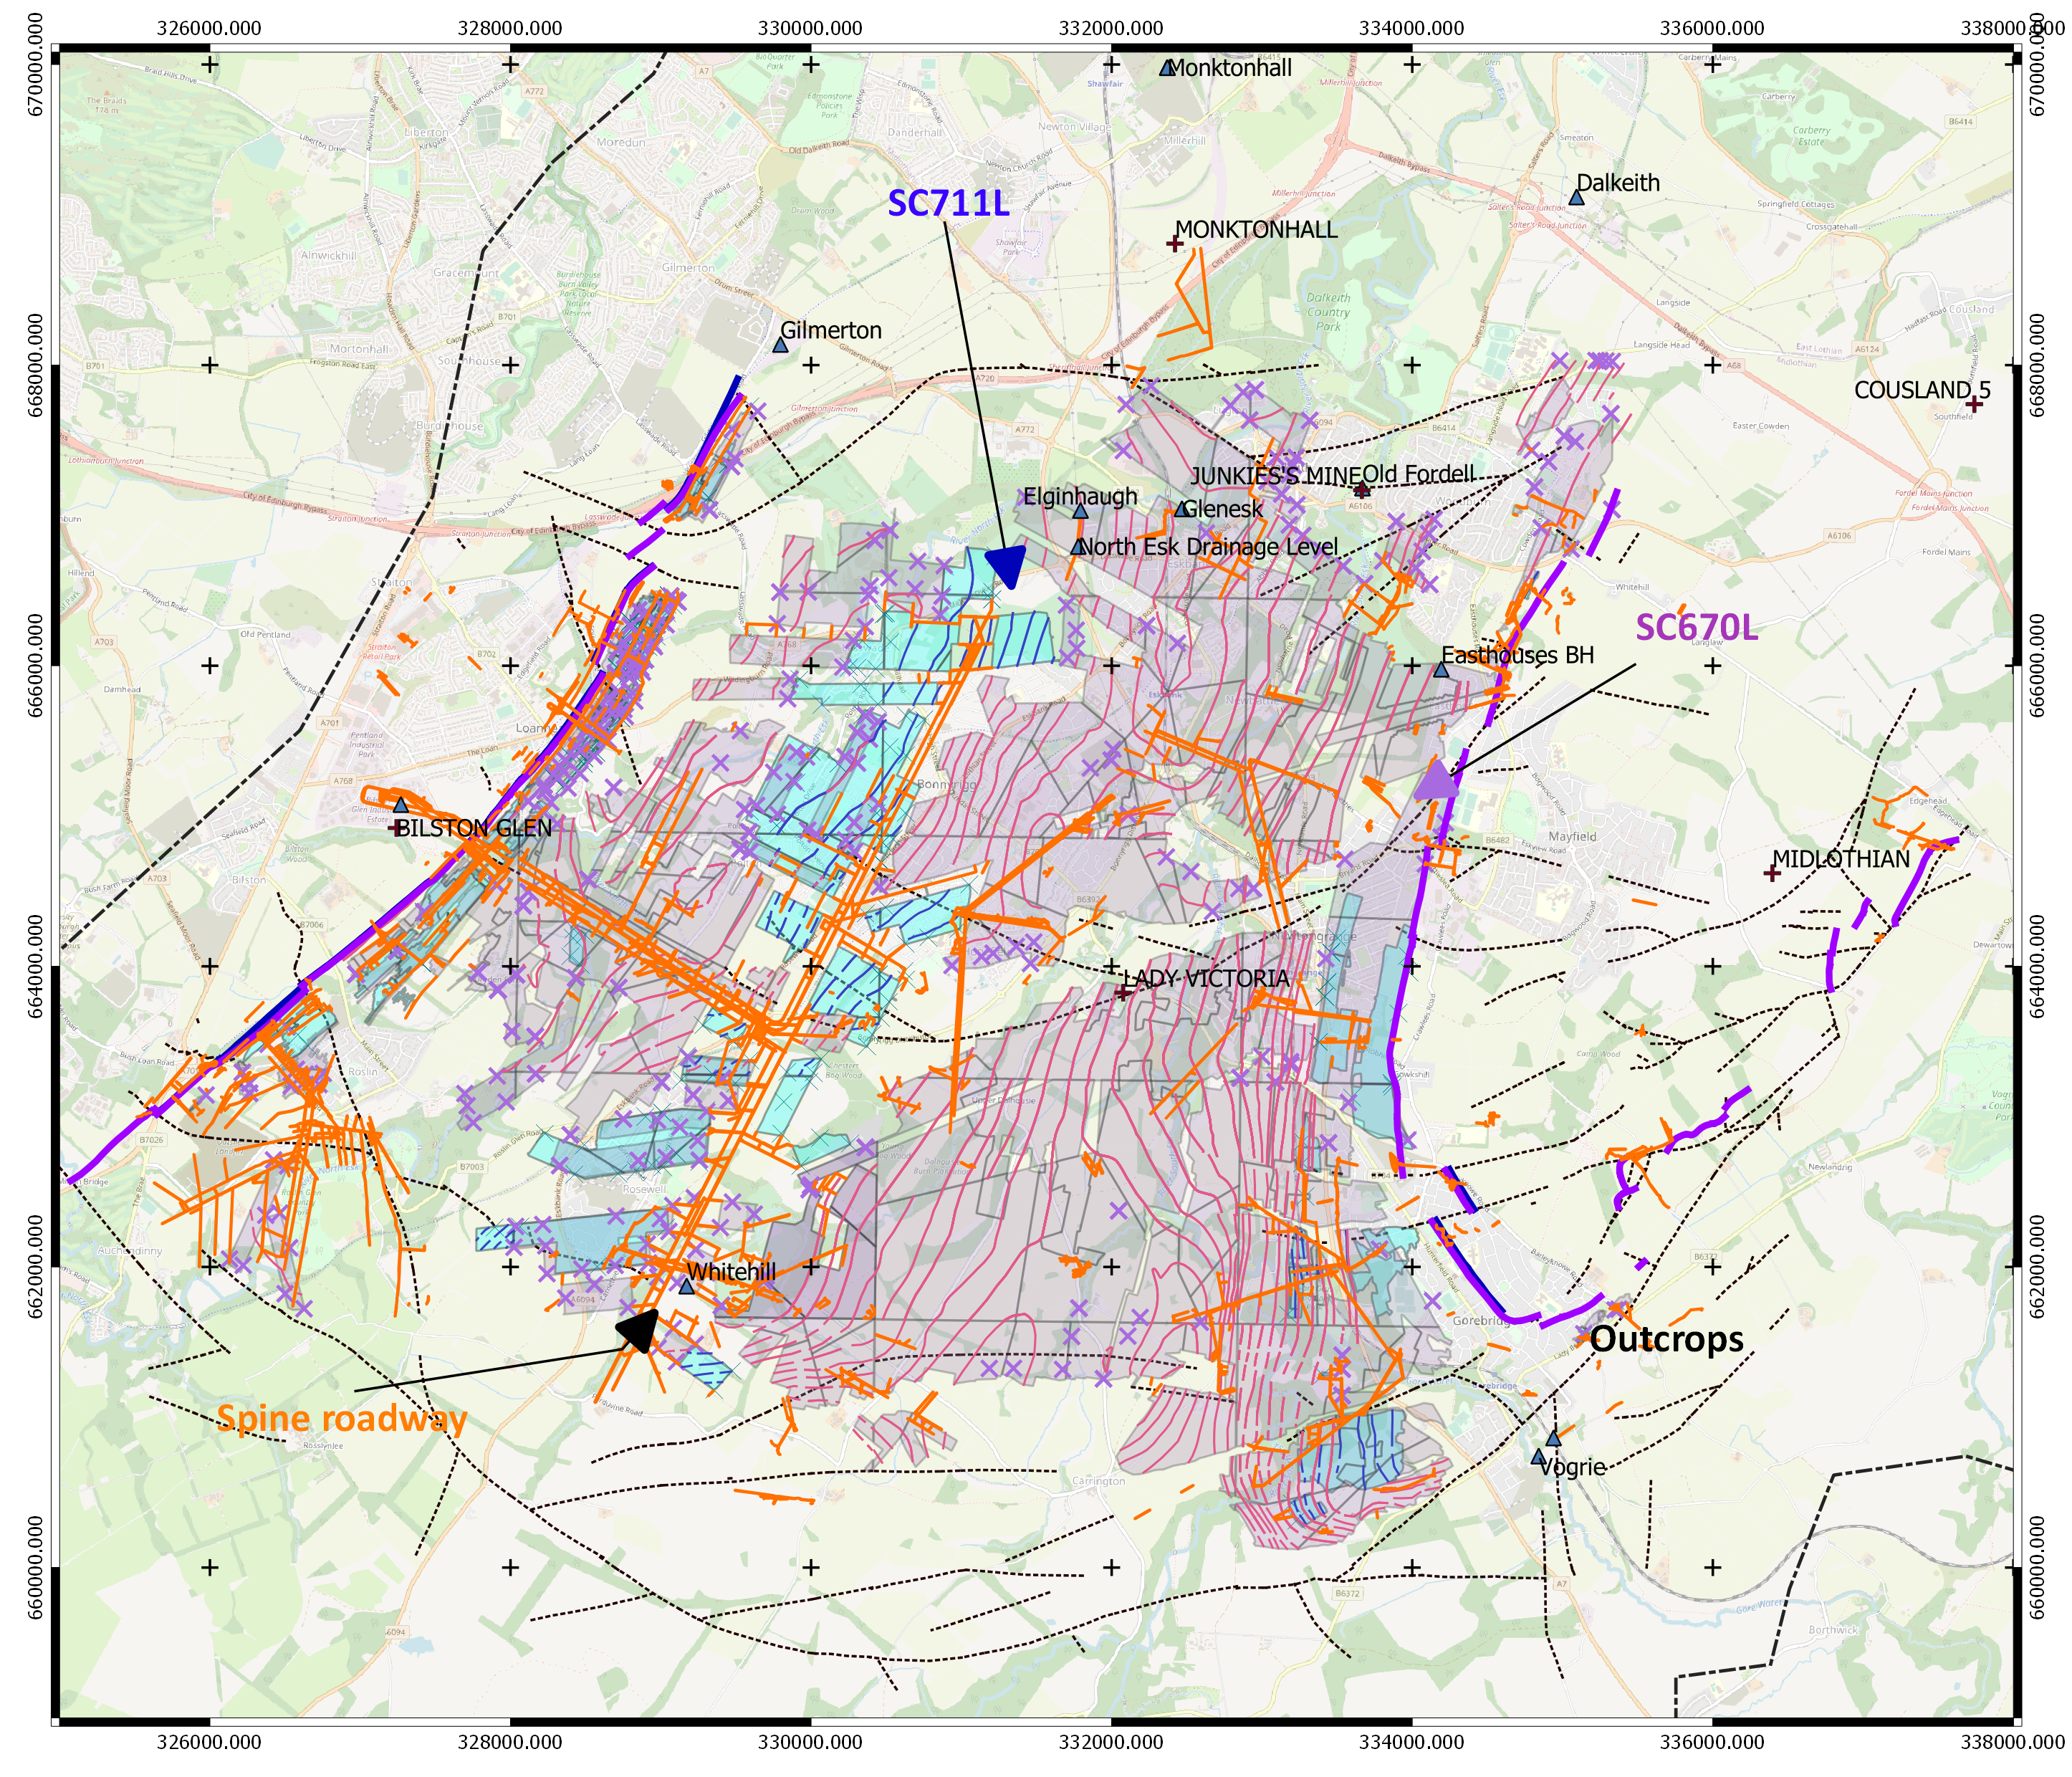
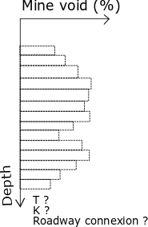
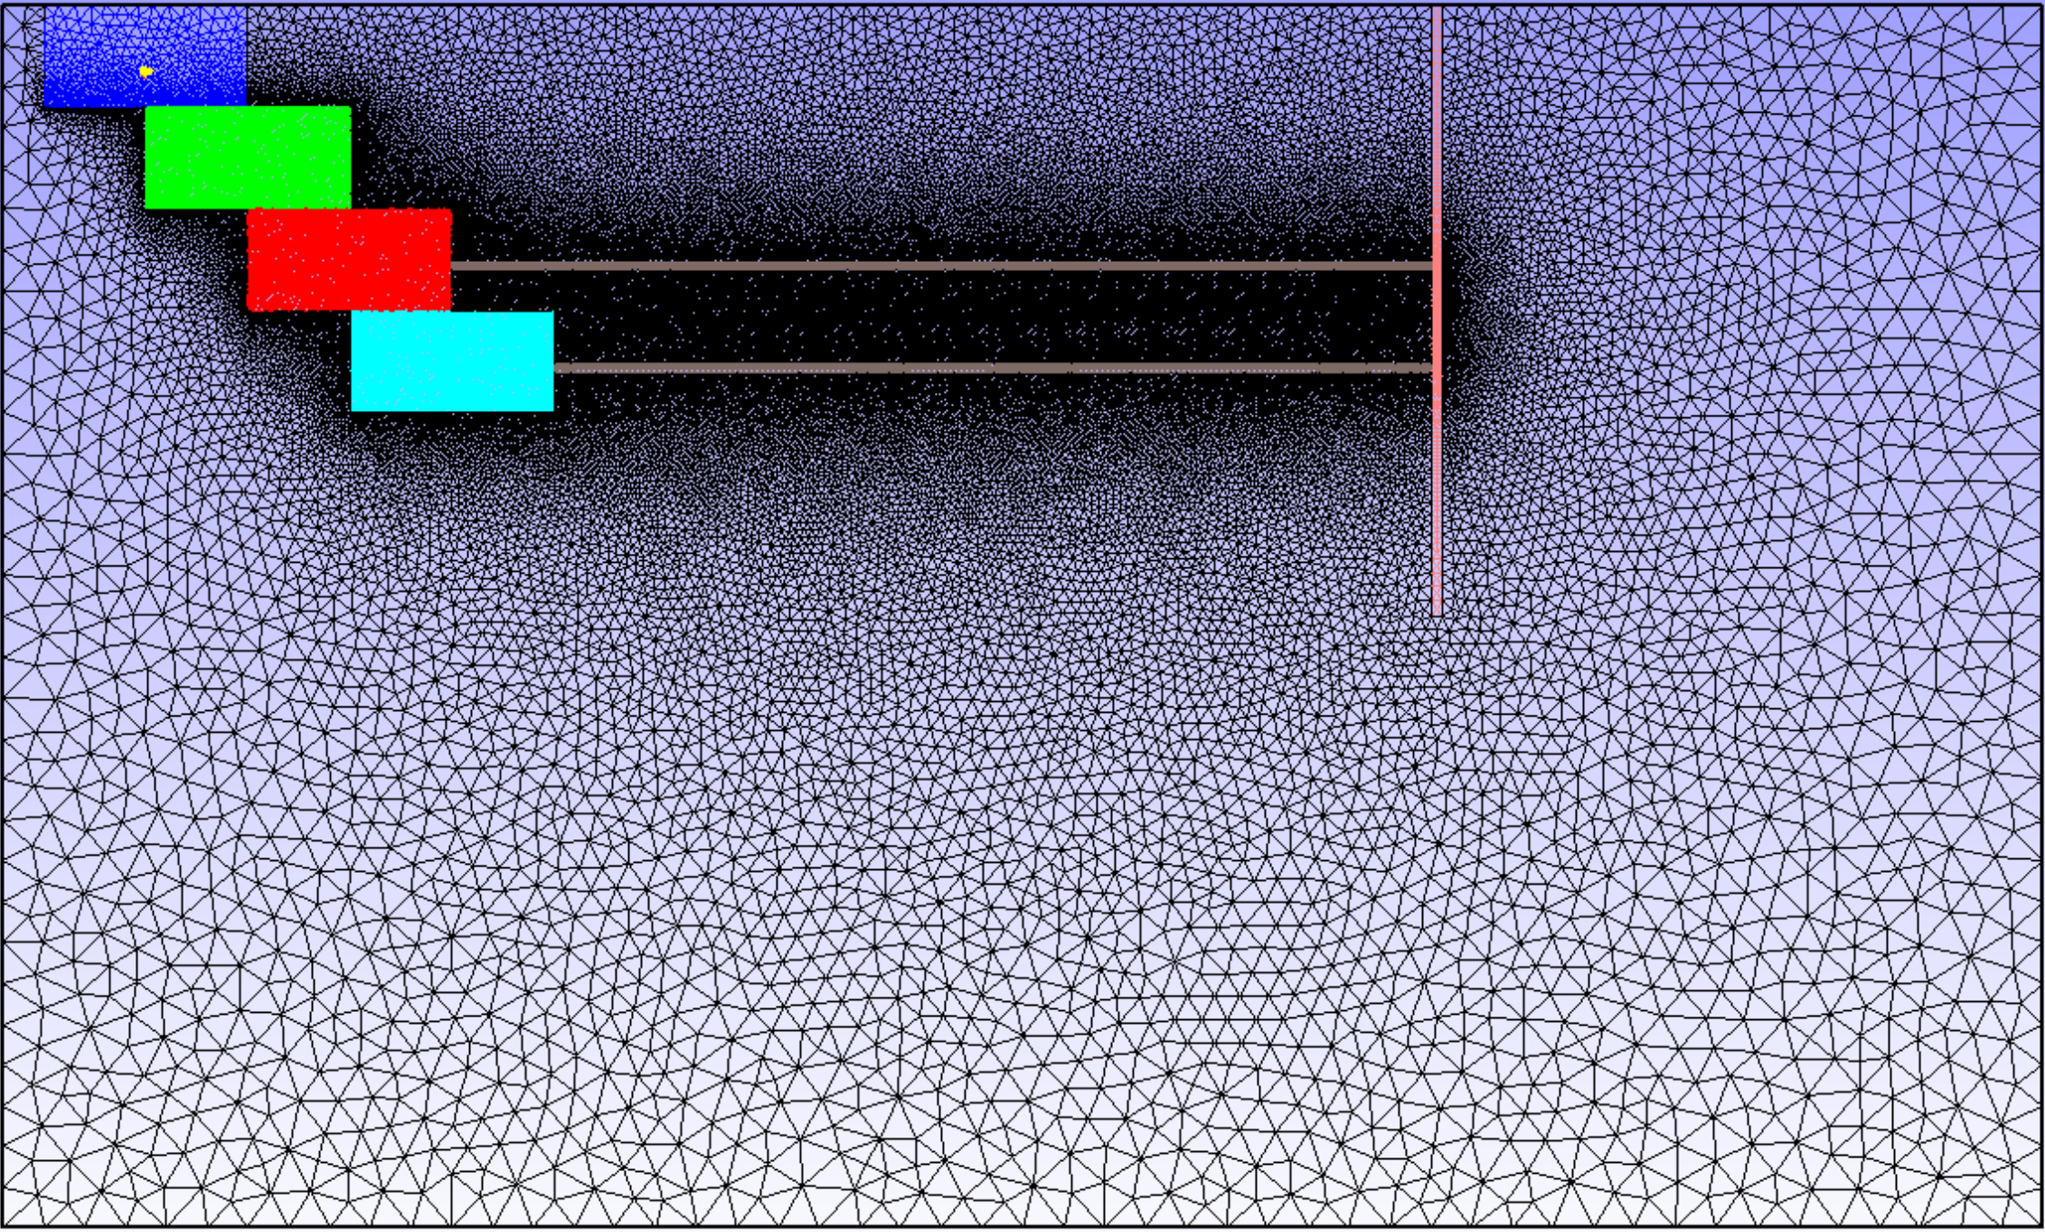


Proposed approach
Introduction
Chapter 2
Chapter 3
Chapter 1
Methods
Conclusion
H1 – Determination of "equivalent porosity" and "equivalent heat capacity" parameter
Mine geometry simplification
Digitalized GIS shapefile
Roadway, shaft & mine interconnections
Statistical distribution of mine workings with depth
$$\frac{\sum_{1}^{n}{[\left(A_{worked} ×h_{worked}\right)}×f]}{V_{mine volume}}$$
f=$0.25$
Notes:
A series of model will be created through the development of a methodology to generate a representative statistical distribution of mine working network / roadways.
Calibration and validation of model using existing data.

Slide 21


Proposed approach
Introduction
Chapter 2
Chapter 3
Chapter 1
Methods
Conclusion
H2 - The lateral extent, volume and interconnectivity of the roadway network is a key control on the overall heat capacity of the mine (i.e. heat depletion rate).
Notes:
What is the time necessary for water to heat up and what is the geothermal potential of mines?
Based on calibrated model, evaluation of the recharge rate / heat recovery rate of mine water. How long can it be sustained? what is the footprint area for providing heat for domestic heating?

Slide 22
Expected outcome
Introduction
Chapter 2
Chapter 3
Chapter 1
Methods
Conclusion
Year 1
Year2
Year3
Conceptual modeling
Sensitivity analysis
Post-mining heat distribution in mines
Geometrical analysis
Geothermal potential evaluation
Advective/diffusive transport
Vertical/horizontal heat fluxes
Heat extraction model
Case study
Spatial analysis of temperature distribution in the UK
What are the main control on mine-water temperature?
What is the long-term heat capacity of flooded mines?
What is the footprint area of heat extraction?
Development of an analytical/numerical tool
Predict extracted water temperature over time
Assess the footprint of heat extraction on the subsurface
Guide licensing of heat
Notes:
Comparison between mine geometries, measurements types, the local geology and temperature at different mines will be cross correlated with results from models to answer the question: Why different mines have different temperatures ?
Heat transfers does’t have a clear boundary
Need to guide the licensing of heat through the development a predictive tool for the Coal authority.

Slide 23
REFERENCES
Adams, C., Monaghan, A., Gluyas, J., 2019. Mining for Heat. In: WWW.GEOLSOC.ORG.UK/GEOSCIENTIST
Burley, A., Edmunds M., W., and Gale, I. (1984). Catalogue of geothermal data for the land area of the United Kingdom. Second revision. British Geological Survey
Ghoreishi-Madiseh, S. A., Ghomshei, M. M., Hassani, F. P., and Abbasy, F. (2012). Sustainable heat extraction from abandoned mine tunnels: A numerical model. J. Renewable Sustainable Energy, p. 17.
Gillespie, M., Crane, E., and Barron, H. (2013). Study into the Potential for Deep Geothermal Energy in Scotland - Volume 2. AEC/001/11. Scottish Government, p. 129.
Guo, P., He, M., Zheng, L., and Zhang, N. (2017). A geothermal recycling system for cooling and heating in
deep mines. Applied Thermal Engineering [online]. 116, pp. 833–839. ISSN: 13594311. DOI: 10.1016/j. applthermaleng.2017.01.116
Hamm, V., Bazargan Sabet, B. 2010. Modelling of fluid flow and heat transfer to assess the geothermal potential of a flooded coal mine in Lorraine, France. Geothermics, 39.2, p. 177-186. doi.org/10.1016/j.geothermics.2010.03.004.
O Dochartaigh, B., Macdonald, A., Fitzsimons, V., and Ward, R. (2015). Scotland’s aquifers and groundwater
bodies. Geological Survey Open Report OR/15/028. British Geological Survey, p. 76.
Raymond, J. and Therrien, R. (2008). Low-temperature geothermal potential of the flooded Gaspé Mines, Québec, Canada. Geothermics. 37.2, pp. 189–210. DOI: 10.1016/j.geothermics.2007.10.001.
Todd, F., McDermott, C., Harris, A. F., Bond, A., and Gilfillan, S. (2019). Coupled hydraulic and mechanical model of surface uplift due to mine water rebound: implications for mine water heating and cooling schemes. Scottish Journal of Geology [online], sjg2018–028. ISSN: 0036-9276, 2041-4951. DOI: 10.1144/sjg2018-028.

Slide 24

THANK YOU !

Slide 25


Back Up

Slide 26



Back Up
Mine structure
Underground workings:
Pillar and stall
Longwall mining
Main pathways :
Shafts
Roadways
Layout of stoop and room mine workings (top) and longwall mining (bottom). From Younger and Adams, 1999.

Slide 27



Initial Results
Introduction
Chapter 2
Chapter 3
Chapter 1
Methods
Conclusion
Contribution from RHP

